Slide 1
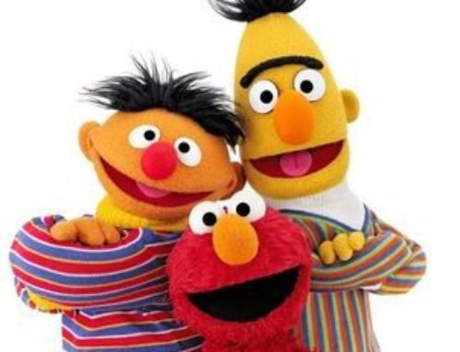
Attention I

Slide 2
Announcements
Vote!
Submit your reading questions by Wed 10/28 noon on Ed.
Exercise was due 10:15 am, next coming up today.
Project Milestone 1 - due 10/29 - 10:15 AM

Slide 3
Outline
Seq2seq with attention
Transformers
Bert
Notes:
As a reminder, this is where we are.

Slide 4
Outline
Seq2seq with attention
Transformers
Bert
Notes:
As a reminder, this is where we are.

Slide 5
Sequence-to-Sequence (seq2seq)
See any issues with this traditional seq2seq paradigm?

Slide 6
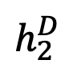

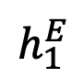
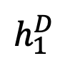


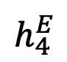
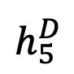
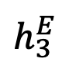

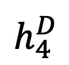
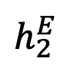
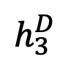

Sequence-to-Sequence (seq2seq)
It’s crazy that the entire “meaning” of the 1st sequence is expected to be packed into this one embedding, and that the encoder then never interacts w/ the decoder again. Hands free.
$${\hat{y}}_{1}$$
$${\hat{y}}_{2}$$
$${\hat{y}}_{3}$$
$${\hat{y}}_{4}$$
$${\hat{y}}_{5}$$
$$h_{1}^{E}$$
$$h_{2}^{E}$$
$$h_{3}^{E}$$
$$h_{4}^{E}$$
$$h_{1}^{D}$$
$$h_{2}^{D}$$
$$h_{3}^{D}$$
$$h_{4}^{D}$$
$$h_{5}^{D}$$
Hidden layer
Input layer
The
brown
dog
ran
Le
chien
brun
a
couru
ENCODER RNN
DECODER RNN

Slide 7
Sequence-to-Sequence (seq2seq)
Instead, what if the decoder, at each step, pays attention to a distribution of all of the encoder’s hidden states?

Slide 8
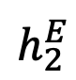
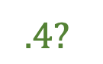
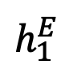
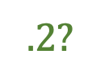
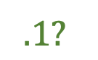
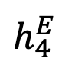
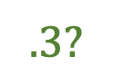
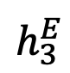
seq2seq + Attention
Q: How do we determine how much to pay attention to each of the encoder’s hidden layers?
$$.4?$$
$$.3?$$
$$.1?$$
$$.2?$$
$$h_{1}^{E}$$
$$h_{2}^{E}$$
$$h_{3}^{E}$$
$$h_{4}^{E}$$
Hidden layer
Input layer
The
brown
dog
ran
ENCODER RNN

Slide 9
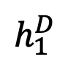
seq2seq + Attention
Q: How do we determine how much to pay attention to each of the encoder’s hidden layers?
A: Let’s base it on our decoder’s previous hidden state (our latest representation of meaning) and all of the encoder’s hidden layers!
$$h_{1}^{E}$$
$$h_{2}^{E}$$
$$h_{3}^{E}$$
$$h_{4}^{E}$$
$$h_{1}^{D}$$
Hidden layer
<s>
Input layer
The
brown
dog
ran
ENCODER RNN

Slide 10
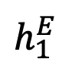
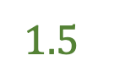
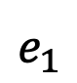
seq2seq + Attention
Q: How do we determine how much to pay attention to each of the encoder’s hidden layers?
A: Let’s base it on our decoder’s previous hidden state (our latest representation of meaning) and all of the encoder’s hidden layers! We want to measure similarity between decoder hidden state and encoder hidden stateS in some ways.
Could be cosine similarity
$$h_{1}^{E}$$
$$h_{2}^{E}$$
$$h_{3}^{E}$$
$$h_{4}^{E}$$
$$h_{1}^{D}$$
$$e_{1}$$
$$1.5$$
Hidden layer
<s>
$$h_{1}^{E}$$
$$h_{1}^{D}$$
Separate FFNN
Input layer
The
brown
dog
ran
ENCODER RNN
DECODER RNN
ATTENTION LAYER

Slide 11
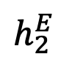
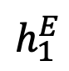
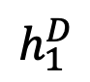
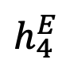
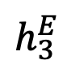
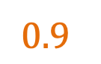
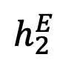
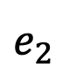
seq2seq + Attention
Q: How do we determine how much to pay attention to each of the encoder’s hidden layers?
A: Let’s base it on our decoder’s previous hidden state (our latest representation of meaning) and all of the encoder’s hidden layers! We want to measure similarity between decoder hidden state and encoder hidden stateS in some ways.
Could be cosine similarity
$$h_{1}^{E}$$
$$h_{2}^{E}$$
$$h_{3}^{E}$$
$$h_{4}^{E}$$
$$h_{1}^{D}$$
$$e_{2}$$
$$0.9$$
Hidden layer
<s>
$$h_{2}^{E}$$
$$h_{1}^{D}$$
Separate FFNN
Input layer
The
brown
dog
ran
ENCODER RNN
DECODER RNN
ATTENTION LAYER

Slide 12
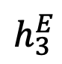
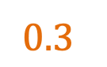
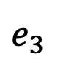
seq2seq + Attention
Q: How do we determine how much to pay attention to each of the encoder’s hidden layers?
A: Let’s base it on our decoder’s previous hidden state (our latest representation of meaning) and all of the encoder’s hidden layers! We want to measure similarity between decoder hidden state and encoder hidden stateS in some ways.
Could be cosine similarity
$$h_{1}^{E}$$
$$h_{2}^{E}$$
$$h_{3}^{E}$$
$$h_{4}^{E}$$
$$h_{1}^{D}$$
$$e_{3}$$
$$0.3$$
Hidden layer
<s>
$$h_{3}^{E}$$
$$h_{1}^{D}$$
Separate FFNN
Input layer
The
brown
dog
ran
ENCODER RNN
DECODER RNN
ATTENTION LAYER

Slide 13
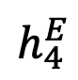
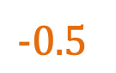
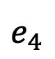
seq2seq + Attention
Q: How do we determine how much to pay attention to each of the encoder’s hidden layers?
A: Let’s base it on our decoder’s previous hidden state (our latest representation of meaning) and all of the encoder’s hidden layers! We want to measure similarity between decoder hidden state and encoder hidden stateS in some ways.
Could be cosine similarity
$$h_{1}^{E}$$
$$h_{2}^{E}$$
$$h_{3}^{E}$$
$$h_{4}^{E}$$
$$h_{1}^{D}$$
$$e_{4}$$
$$−0.5$$
Hidden layer
<s>
$$h_{4}^{E}$$
$$h_{1}^{D}$$
Separate FFNN
Input layer
The
brown
dog
ran
ENCODER RNN
DECODER RNN
ATTENTION LAYER

Slide 14
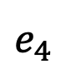
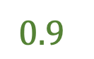
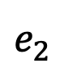
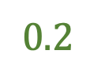
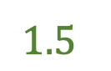
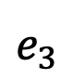
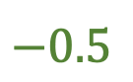
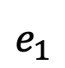
seq2seq + Attention
Q: How do we determine how much to pay attention to each of the encoder’s hidden layers?
A: Let’s base it on our decoder’s previous hidden state (our latest representation of meaning) and all of the encoder’s hidden layers!
Attention (raw scores)
$$h_{1}^{E}$$
$$h_{2}^{E}$$
$$h_{3}^{E}$$
$$h_{4}^{E}$$
$$h_{1}^{D}$$
$$e_{1}$$
$$1.5$$
$$e_{2}$$
$$0.9$$
$$e_{3}$$
$$0.2$$
Hidden layer
$$e_{4}$$
$$−0.5$$
<s>
Input layer
The
brown
dog
ran
ENCODER RNN
DECODER RNN
ATTENTION LAYER

Slide 15
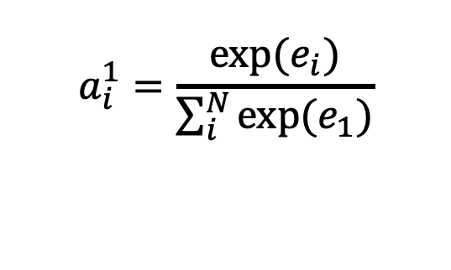
seq2seq + Attention
Q: How do we determine how much to pay attention to each of the encoder’s hidden layers?
A: Let’s base it on our decoder’s previous hidden state (our latest representation of meaning) and all of the encoder’s hidden layers!
Attention (raw scores)
$$h_{1}^{E}$$
$$h_{2}^{E}$$
$$h_{3}^{E}$$
$$h_{4}^{E}$$
$$h_{1}^{D}$$
$$e_{1}$$
$$1.5$$
$$e_{2}$$
$$0.9$$
$$e_{3}$$
$$0.2$$
Hidden layer
$$e_{4}$$
$$−0.5$$
Attention (softmax’d)
<s>
$$a_{i}^{1}=\frac{exp⁡(e_{i})}{\sum_{i}^{N}{{exp⁡(e}_{1})}}$$
Input layer
The
brown
dog
ran
ENCODER RNN
DECODER RNN
ATTENTION LAYER

Slide 16




seq2seq + Attention
Q: How do we determine how much to pay attention to each of the encoder’s hidden layers?
A: Let’s base it on our decoder’s previous hidden state (our latest representation of meaning) and all of the encoder’s hidden layers!
Attention (raw scores)
$$h_{1}^{E}$$
$$h_{2}^{E}$$
$$h_{3}^{E}$$
$$h_{4}^{E}$$
$$h_{1}^{D}$$
$$e_{1}$$
$$1.5$$
$$e_{2}$$
$$0.9$$
$$e_{3}$$
$$0.2$$
Hidden layer
$$e_{4}$$
$$−0.5$$
Attention (softmax’d)
<s>
$$a_{1}^{1}=0.51$$
Input layer
The
brown
dog
ran
$$a_{2}^{1}=0.28$$
$$a_{3}^{1}=0.14$$
ENCODER RNN
$$a_{3}^{1}=0.07$$

Slide 17

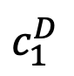
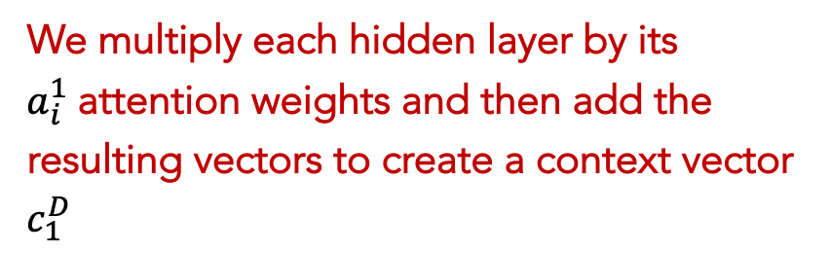
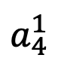
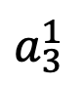

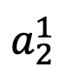

seq2seq + Attention
$$c_{1}^{D}$$
We multiply each hidden layer by its $a_{i}^{1}$attention weights and then add the resulting vectors to create a context vector $c_{1}^{D}$
$$a_{1}^{1}$$
$$a_{2}^{1}$$
$$a_{3}^{1}$$
$$a_{4}^{1}$$
$$h_{1}^{E}$$
$$h_{2}^{E}$$
$$h_{3}^{E}$$
$$h_{4}^{E}$$
$$h_{1}^{D}$$
Hidden layer
Attention (softmax’d)
<s>
$$a_{1}^{1}=0.51$$
Input layer
The
brown
dog
ran
$$a_{2}^{1}=0.28$$
$$a_{3}^{1}=0.14$$
ENCODER RNN
$$a_{4}^{1}=0.07$$

Slide 18







seq2seq + Attention
NOTE: each attention weight $a_{i}^{j}$ is based on the decoder’s current hidden state, too.
$$c_{1}^{D}$$
El
$${\hat{y}}_{1}$$
$$a_{1}^{1}$$
$$a_{2}^{1}$$
$$a_{3}^{1}$$
$$a_{4}^{1}$$
Hidden layer
$[c_{1}^{D}$,<S>$]$
Input layer
The
brown
dog
ran
DECODER RNN
ENCODER RNN

Slide 19


seq2seq + Attention
NOTE: each attention weight $a_{i}^{j}$ is based on the decoder’s current hidden state, too.
$$c_{1}^{D}$$
El
perro
$${\hat{y}}_{1}$$
$${\hat{y}}_{2}$$
$$a_{1}^{1}$$
$$a_{2}^{1}$$
$$a_{3}^{1}$$
$$a_{4}^{1}$$
Hidden layer
$[c_{1}^{D}$,<S>$]$
$[c_{2}^{D}$,${\hat{y}}_{1}]$
Input layer
The
brown
dog
ran
DECODER RNN
ENCODER RNN

Slide 20






seq2seq + Attention
NOTE: each attention weight $a_{i}^{j}$ is based on the decoder’s current hidden state, too.
$$c_{1}^{D}$$
El
perro
marrón
$${\hat{y}}_{1}$$
$${\hat{y}}_{2}$$
$${\hat{y}}_{3}$$
$$a_{1}^{1}$$
$$a_{2}^{1}$$
$$a_{3}^{1}$$
$$a_{4}^{1}$$
Hidden layer
$[c_{1}^{D}$,<S>$]$
$[c_{2}^{D}$,${\hat{y}}_{1}]$
$[c_{3}^{D}$,${\hat{y}}_{2}]$
Input layer
The
brown
dog
ran
DECODER RNN
ENCODER RNN

Slide 21


seq2seq + Attention
NOTE: each attention weight $a_{i}^{j}$ is based on the decoder’s current hidden state, too.
$$c_{1}^{D}$$
El
perro
marrón
corrio
$${\hat{y}}_{1}$$
$${\hat{y}}_{2}$$
$${\hat{y}}_{3}$$
$${\hat{y}}_{4}$$
$$a_{1}^{1}$$
$$a_{2}^{1}$$
$$a_{3}^{1}$$
$$a_{4}^{1}$$
Hidden layer
$[c_{1}^{D}$,<S>$]$
$[c_{2}^{D}$,${\hat{y}}_{1}]$
$[c_{3}^{D}$,${\hat{y}}_{2}]$
$[c_{4}^{D}$,${\hat{y}}_{3}]$
Input layer
The
brown
dog
ran
DECODER RNN
ENCODER RNN

Slide 22

seq2seq + Attention
Attention:
greatly improves seq2seq results
allows us to visualize the contribution each word gave during each step of the decoder
Image source: Fig 3 in Bahdanau et al., 2015

Slide 23
More reading
Kalchbrenner and Blunsom (2013), Sutskever et. al (2014) and Cho. et. al (2014b)
Bahdanau et. al (2015) https://arxiv.org/abs/1409.0473 seq2seq with bidirectional GRU encoder + attention, score is FFNN.
Luong et. al (2015) https://arxiv.org/abs/1508.04025 Two-stacked LSTMs for the encoder and decoder, score experimented with cosine and FFNN. Context vector and output goes through another FFNN.
Google’s Neural Machine Translation (GNMT) https://arxiv.org/pdf/1609.08144.pdf 8 LSTMs, where the first is bidirectional (whose outputs are concatenated), and a residual connection exists between outputs from consecutive layers (starting from the 3rd layer). The decoder is a separate stack of 8 unidirectional LSTMs.

Slide 24
Outline
Seq2seq with attention
Transformers
Bert
Notes:
As a reminder, this is where we are.

Slide 25
Transformers
The Transformer is a model that uses attention to boost the speed with which seq2seq with attention models can be trained. The biggest benefit, however, comes from how The Transformer lends itself to parallelization. We will break it apart and look at how it functions.
In its heart it contains an encoding component, a decoding component, and connections between them.

Slide 26
The encoding is a stack of encoders.
The original paper stacks six of them on top of each other – there’s nothing magical about the number six, one can definitely experiment with other arrangements).
The decoding is a stack of decoders of the same number.

Slide 27
The encoder’s inputs goes through a self-attention layer – a layer that helps the encoder look at other words in the input sentence as it encodes a specific word.
The decoder has both those layers, but between them is an attention layer that helps the decoder focus on relevant parts of the input sentence (similar what attention does in seq2seq models).

Slide 28

A key property of the Transformer, which is that the word in each position flows through its own path in the encoder. There are dependencies between these paths in the self-attention layer.
The feed-forward layer does not have those dependencies, Therefore, the various paths can be executed in parallel while flowing through the feed-forward layer.

Slide 29


What does “he” in this sentence refer to? Is it referring to the class or to the student? It’s a simple question to a human, but not as simple to an algorithm.
When the model is processing the word “he”, self-attention allows it to associate “he” with “Patrick”.

Slide 30



Slide 31
In the same fashion as CNN that we need more than one filter, transformers add a mechanism called “multi-headed” attention. This improves the performance of the attention layer in two ways:
It expands the model’s ability to focus on different positions.
It gives the attention layer multiple “representation subspaces”

Slide 32

As we encode the word ”he", one attention head is focusing most on ”Patrick", while another is focusing on ”student" -- in a sense, the model's representation of the word ”he" combines the representations of both ”Patrick" and ”stduent".

Slide 33




Slide 34

Details in the architecture of the encoder:
Each sub-layer in each encoder has a residual connection around it
And a layer-normalization step.

Slide 35

Transformer is stacked encoders and decoders.
So far:
Positional encoding
Encoder
Self-attention

Slide 36
decoders
encoder-decoder attention

Slide 37


The Final Linear and Softmax Layer

Slide 38
Outline
Seq2seq with attention
Transformers
Bert
Notes:
As a reminder, this is where we are.

Slide 39
BERT
Bert stands for Bidirectional Encoder Representations from Transformers. It’s google’s new techniques for NLP pre-training language representation. Which means now machine learning communities can use Bert models that have been training already on a large number of words, for NLP models to do a wide variety of tasks such as Question Answering tasks, Named Entity Recognition (NER), and Classification like sentiment analysis.

Slide 40
In Bert paper, they present two types of Bert models one is the Bert Base and the other is Bert Large.

Slide 41

What is the input of Bert?
The input of Bert is a special input start with [CLS] token stand for classification. As in the Transformers, Bert will take a sequence of words (vector) as an input that keeps feed up from the first encoder layer up to the last layer in the stack. Each layer in the stack will apply the self-attention method to the sequence after that it will pass to the feed-forward network to deliver the next encoder layer.

